Slide 1
鲲鹏入珠·向海而兴 珠海鲲鹏应用开发者大赛
——作品答辩
Security Level:

Slide 2
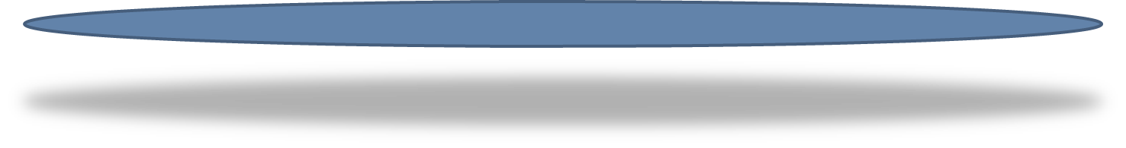
1
团队介绍
2
应用功能
目 录
3
产品展示
CONTENTS
4
部署架构
5
亮点总结

Slide 3
PART 01
团队介绍

Slide 4
开发团队介绍
队名: 农罗王林李
单位: 暨南大学
队员: 罗坤亭（队长）、农凯、王浩宇、林梓扬、李子康
赛题类型：√ 固定赛题 □ 开放赛题
赛题名称：赛题1——园区出入登记系统
作品链接：https://github.com/ChopperCP/KunPengDeveloperContest
https://www.fxlkt.com/

Slide 5
PART 02
应用功能

Slide 6
应用功能
B/S架构：B（微信小程序/网页）
生成并展示用户二维码
用户自己的流水可查看，管理员和安全人员（保安）可扫码用户二维码查看其记录
用户扫园区出入口码可出入，返回结果
管理员后台处理出入异常
100%鲲鹏云服务
标准化日志输出(log4j)
关系型数据存储

Slide 7
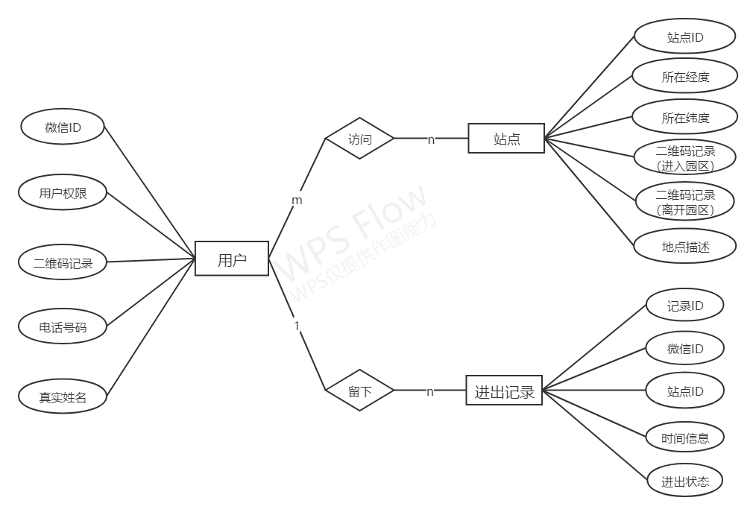
数据库设计

Slide 8
PART 03
产品展示

Slide 9
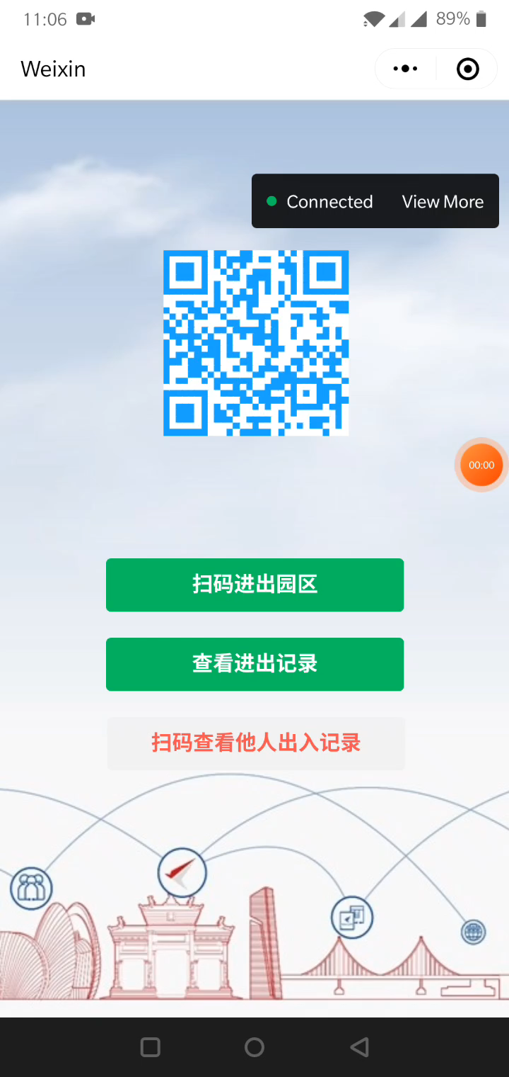



产品展示
入口二维码
出口二维码

Slide 10
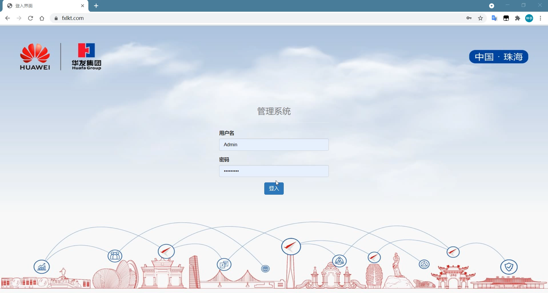
产品展示

Slide 11
PART 04
部署架构

Slide 12
系统架构

Slide 13
结构总结
3台ECS（2*鲲鹏+1*x86） 24/7 做小程序的接口和后台管理界面，当CPU占用>70%时弹性伸缩会根据最新的镜像创建ECS，最多10台。
高可靠：弹性伸缩、ELB负载均衡、DDM数据库中间件+3*GaussDB。
安全性：WAFWeb应用防火墙、HSS主机安全、WebScan漏洞扫描、DDoS流量清洗、态势感知
备份：CBR云服务器备份、异地复制
监控：CES云监控、LTS云日志服务
运维：应用运维管理AOM、统一身份认证服务IAM

Slide 14
PART 05
亮点总结

Slide 15




亮点1：系统完善度较高
微信小程序
后台管理系统
数据库

Slide 16
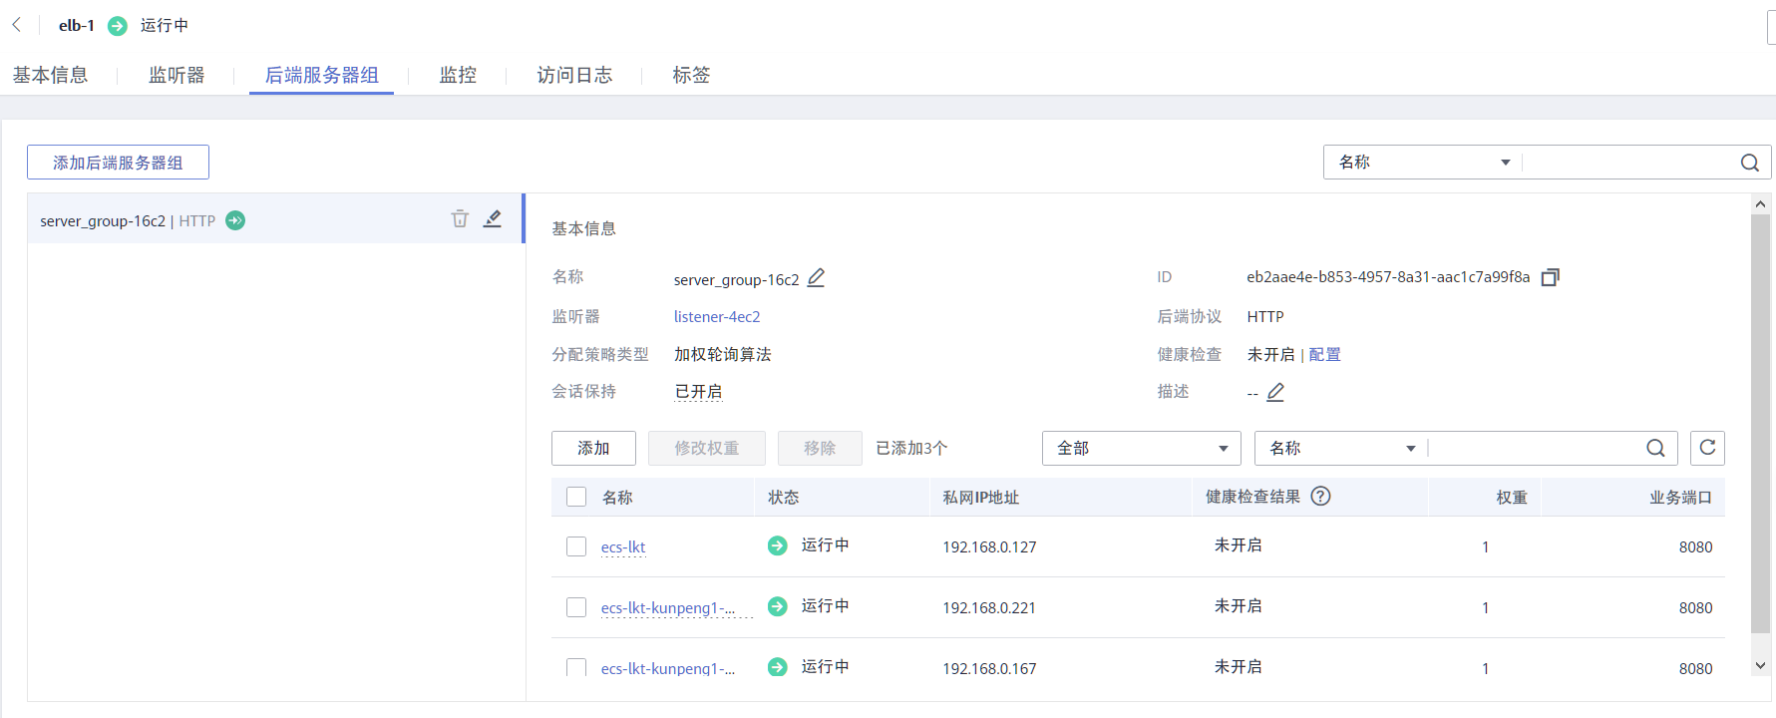
亮点2：ELB负载均衡

Slide 17
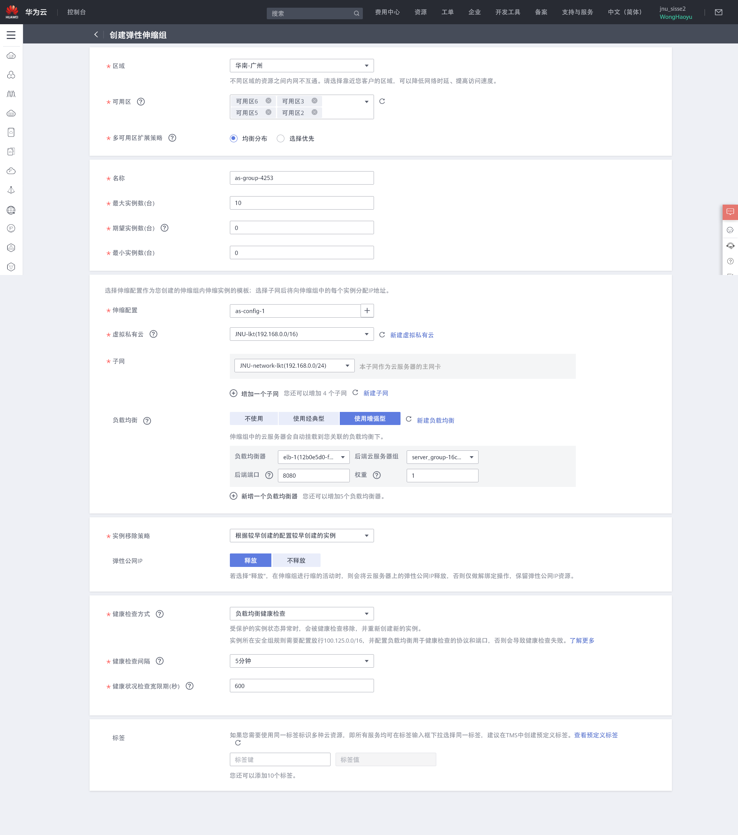
亮点3：AS弹性伸缩
弹性伸缩组

Slide 18
亮点2：AS弹性伸缩

Slide 19
亮点2：AS弹性伸缩

Slide 20
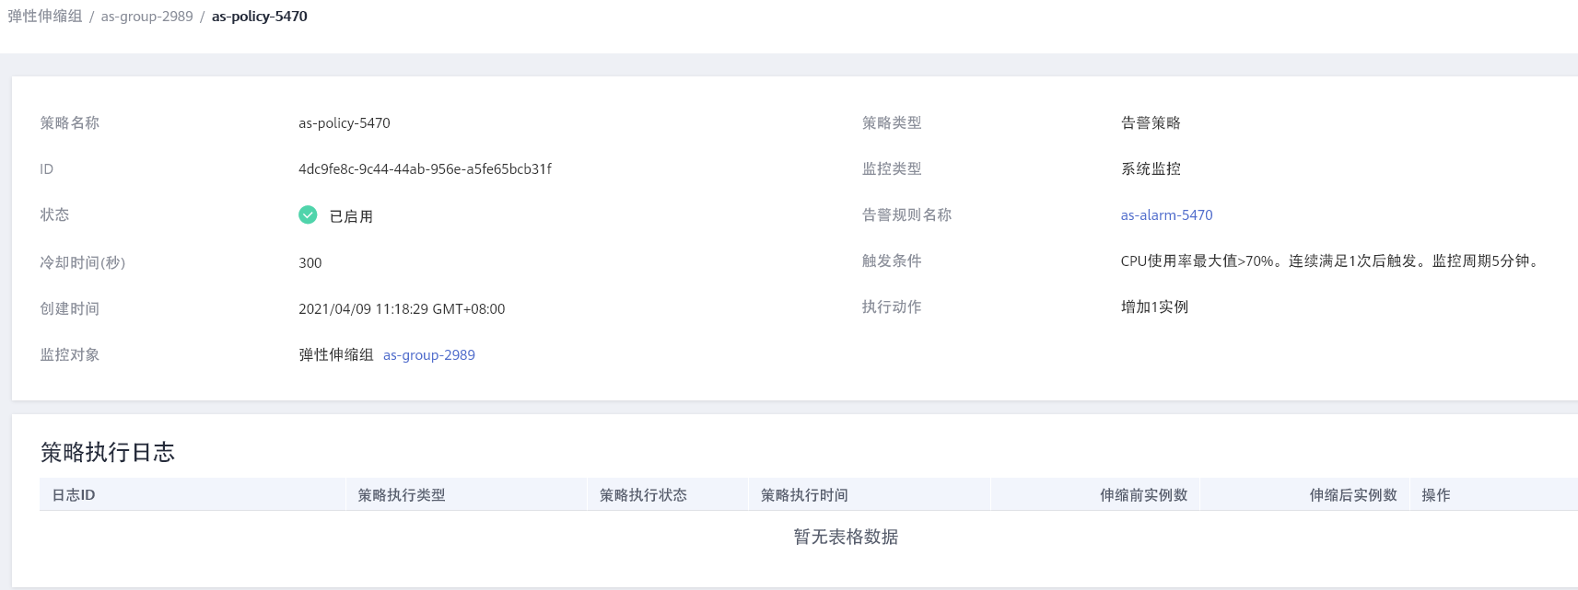
亮点3：AS弹性伸缩
弹性伸缩策略

Slide 21
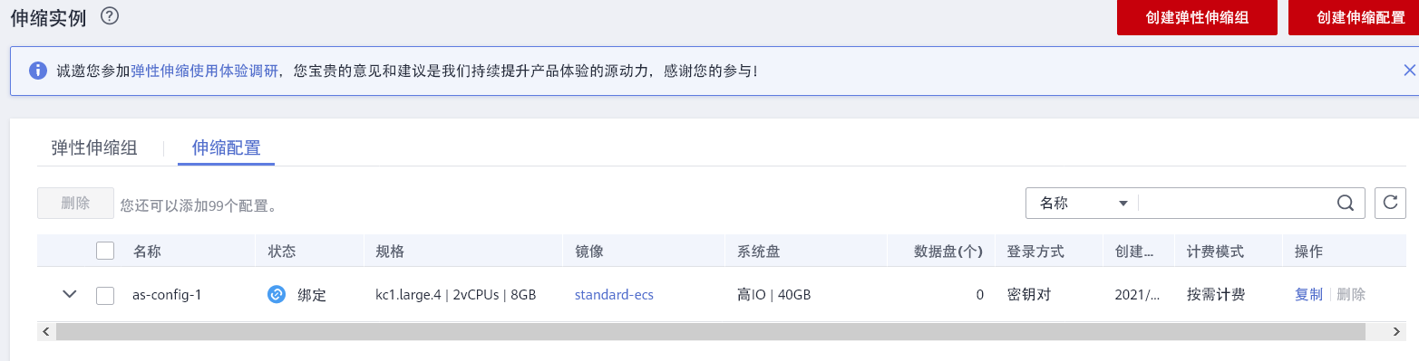
亮点3：AS弹性伸缩
弹性伸缩配置

Slide 22
亮点4：4种安全服务
保障机密性 完整性 可用性

Slide 23
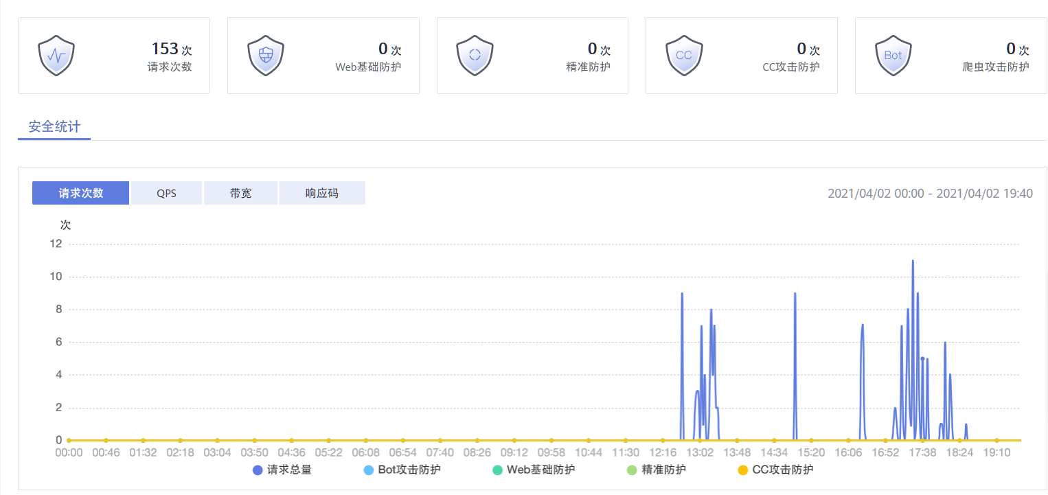
亮点4：4种安全服务
保障机密性 完整性 可用性
WAF

Slide 24
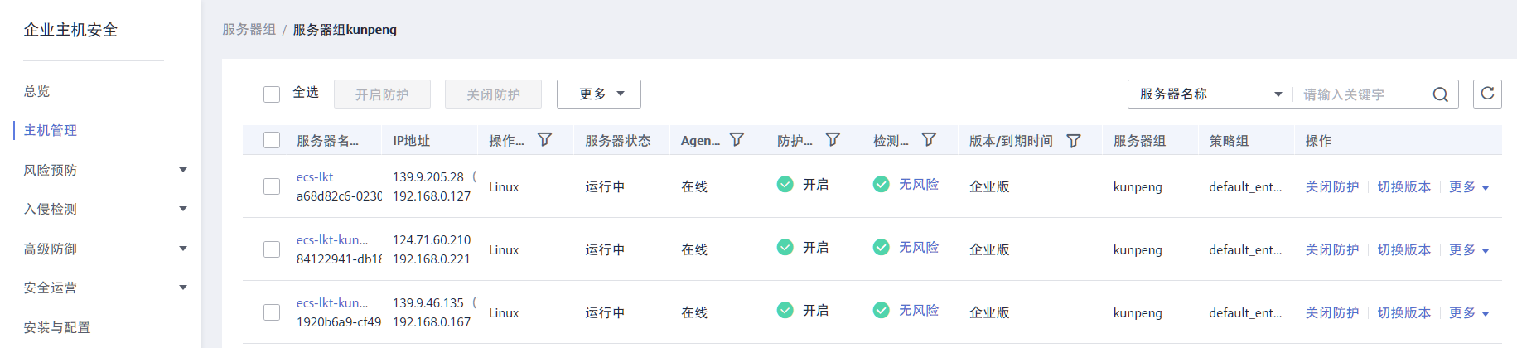
亮点4：4种安全服务
保障机密性 完整性 可用性
HSS

Slide 25
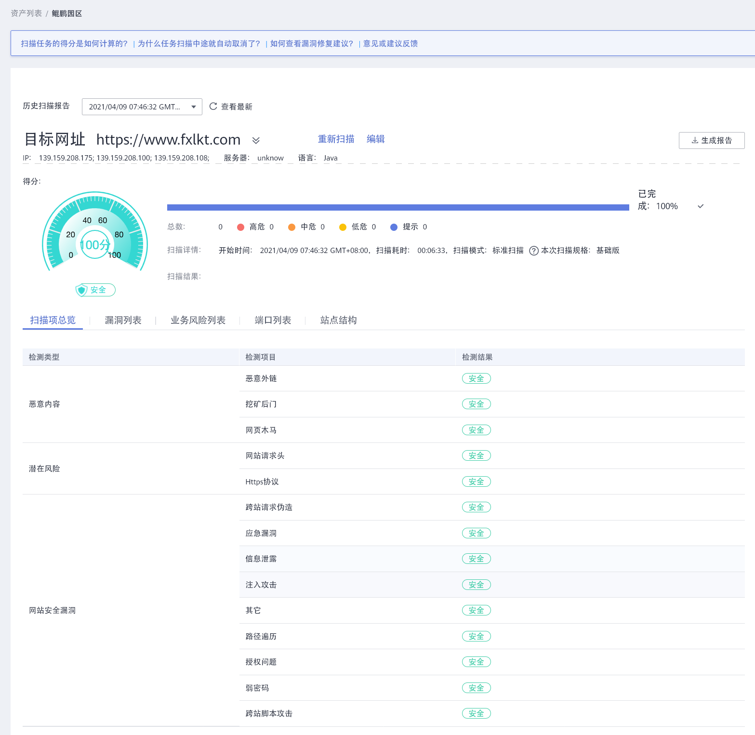
亮点4：4种安全服务
保障机密性 完整性 可用性
WebScan

Slide 26
亮点3：4种安全服务
保障机密性 完整性 可用性
WebScan

Slide 27
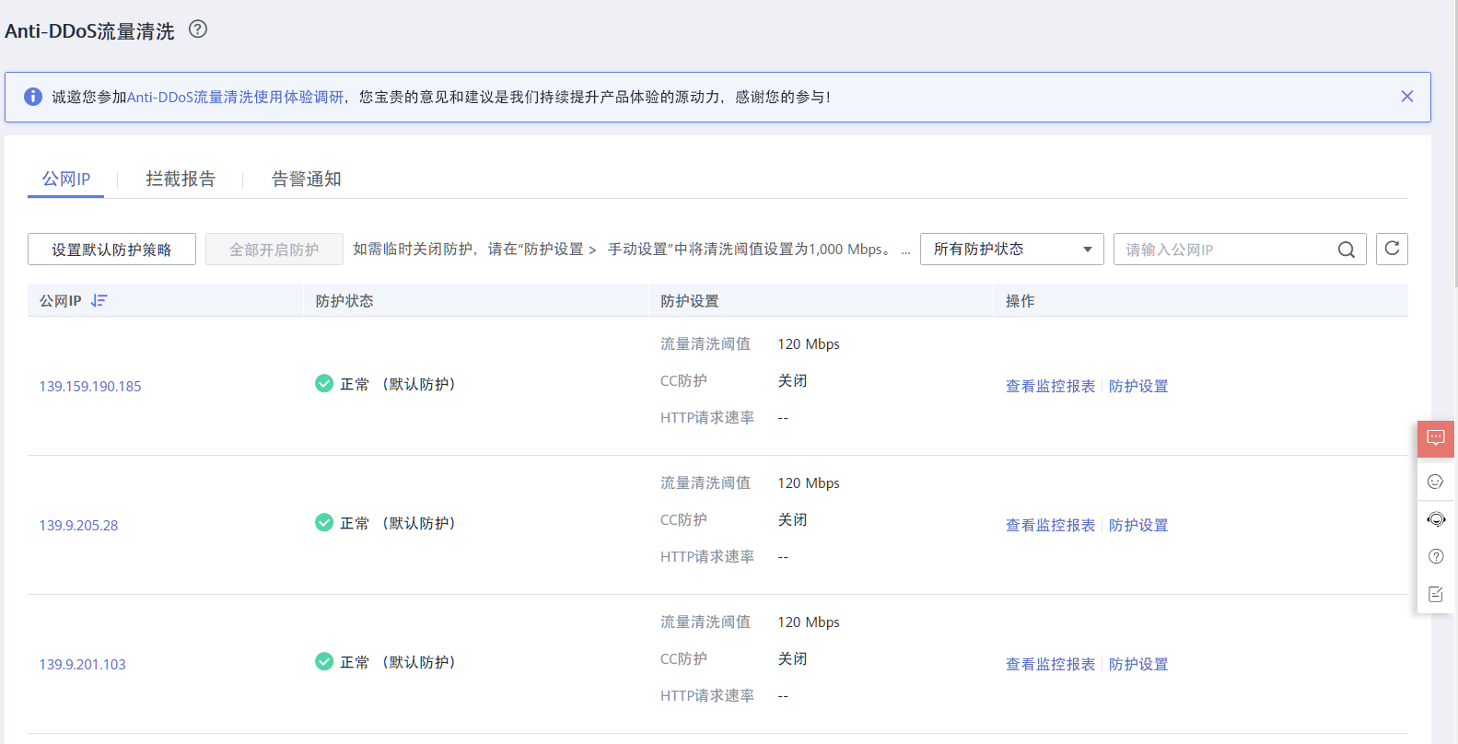
亮点4：4种安全服务
保障机密性 完整性 可用性
DDOS流量清洗

Slide 28
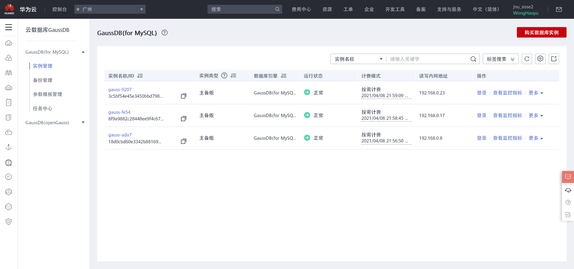
亮点5：GaussDB

Slide 29
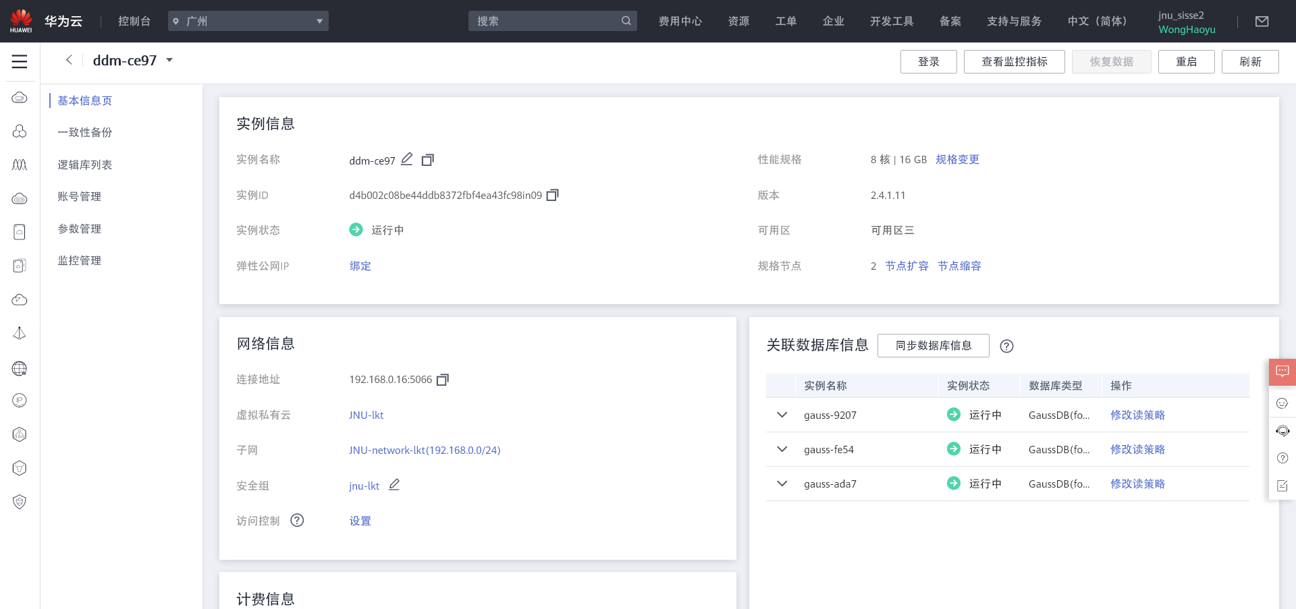
亮点6：DDM数据库中间件

Slide 30
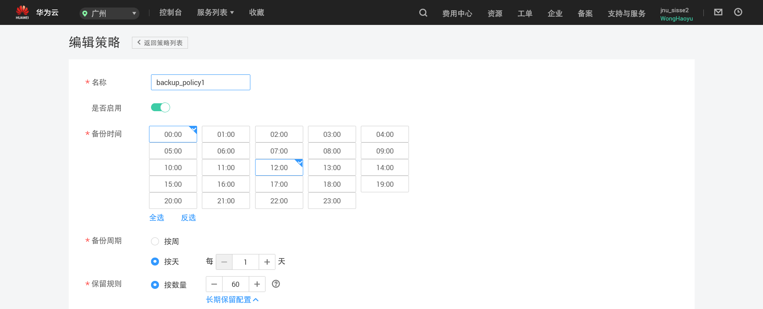
亮点7：CBR云备份
备份策略

Slide 31
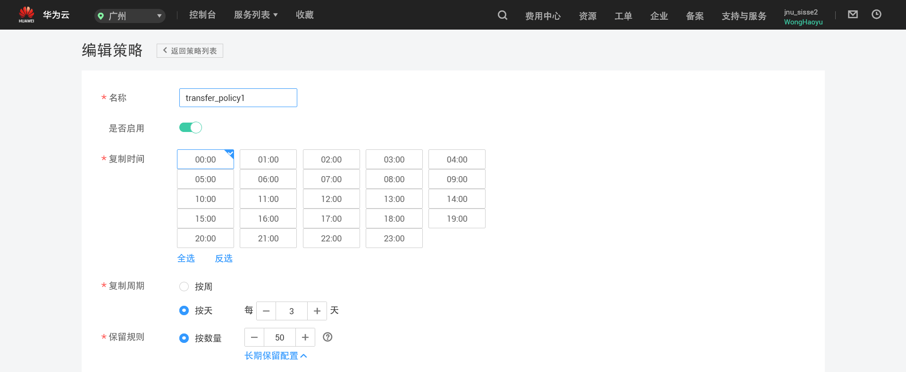
亮点7：CBR云备份
异地复制策略

Slide 32
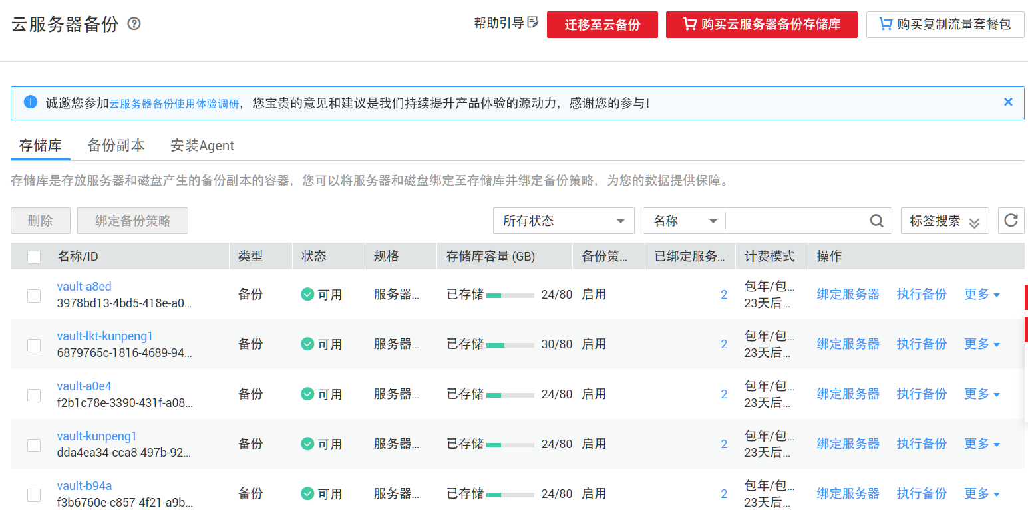
亮点7：CBR云备份
存储库

Slide 33
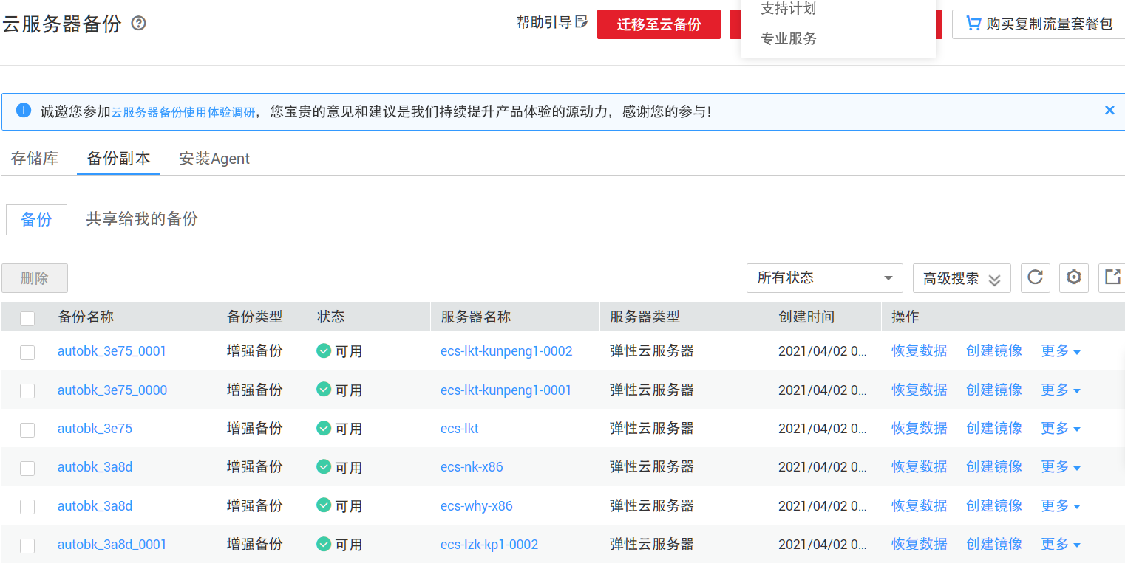
亮点7：CBR云备份
备份副本

Slide 34
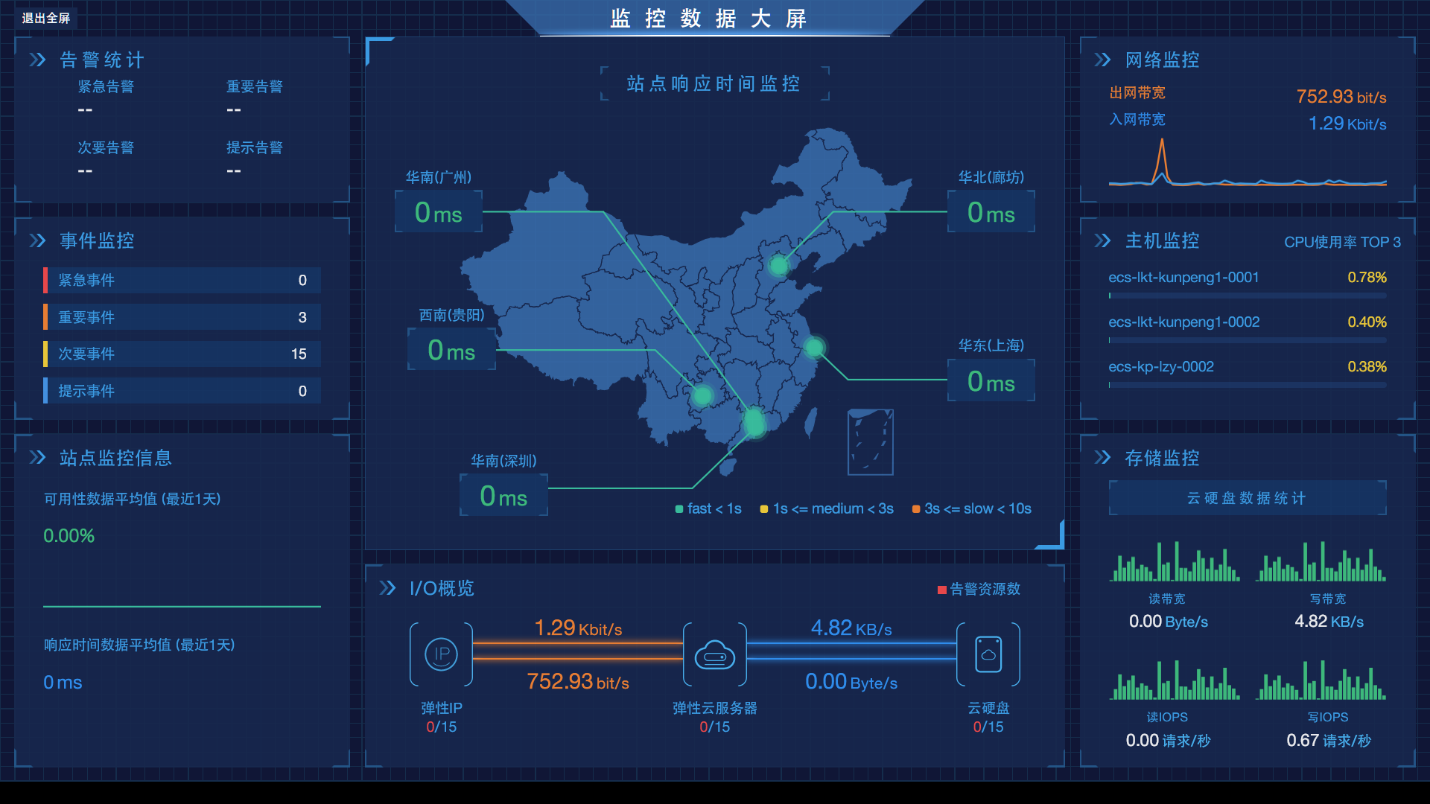
亮点8：CES云监控

Slide 35
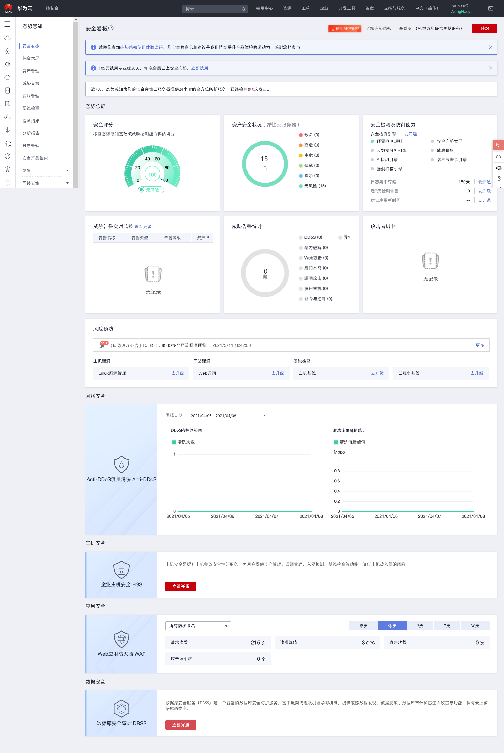
亮点9：SA态势感知

Slide 36
亮点8：AS态势感知

Slide 37
亮点8：AS态势感知

Slide 38
亮点8：AS态势感知

Slide 39
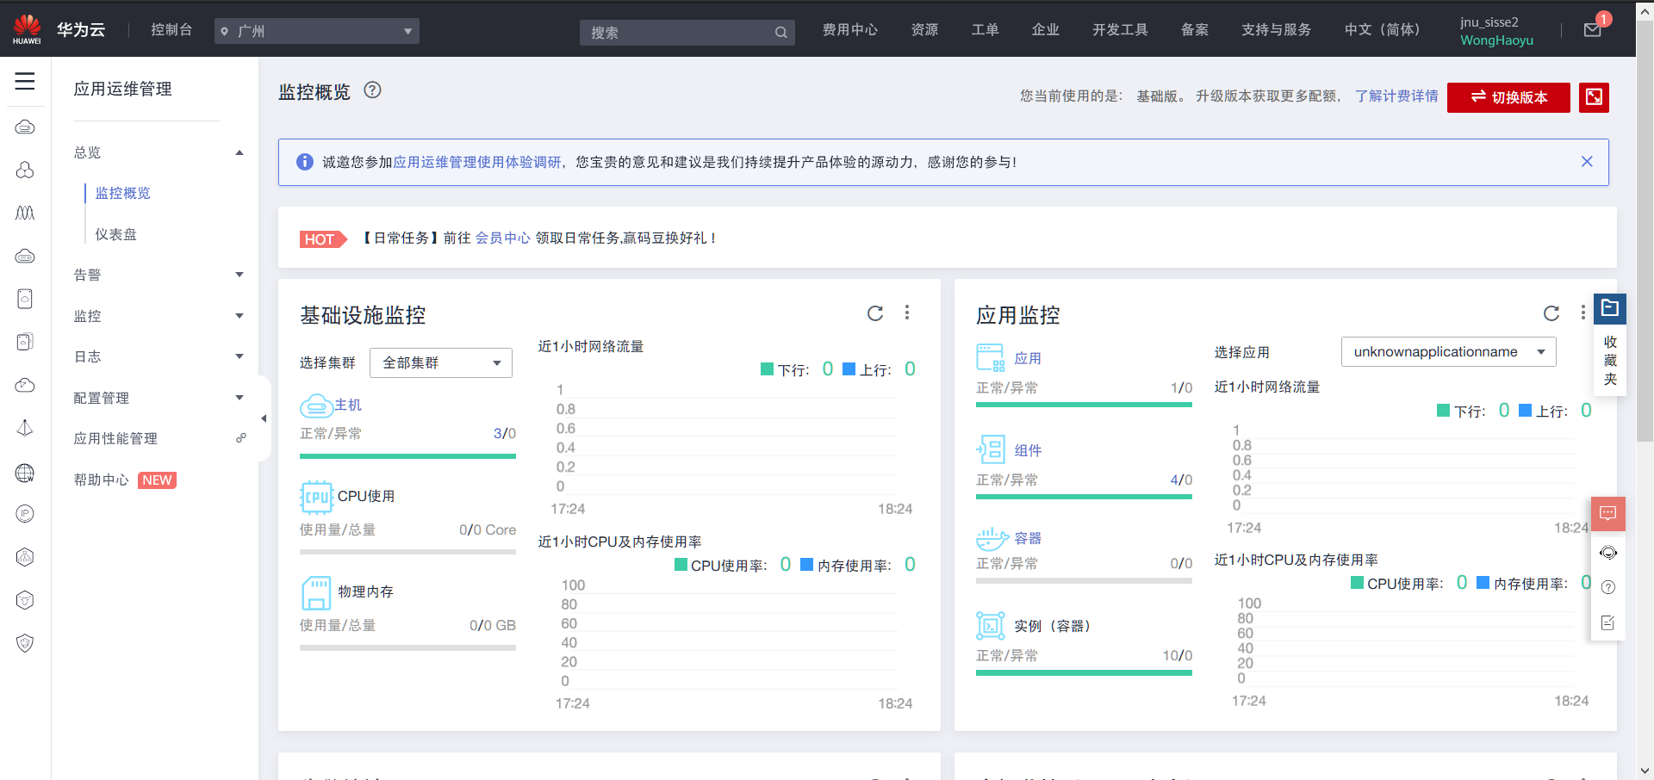
亮点11：AOM应用运维管理
AOM

Slide 40
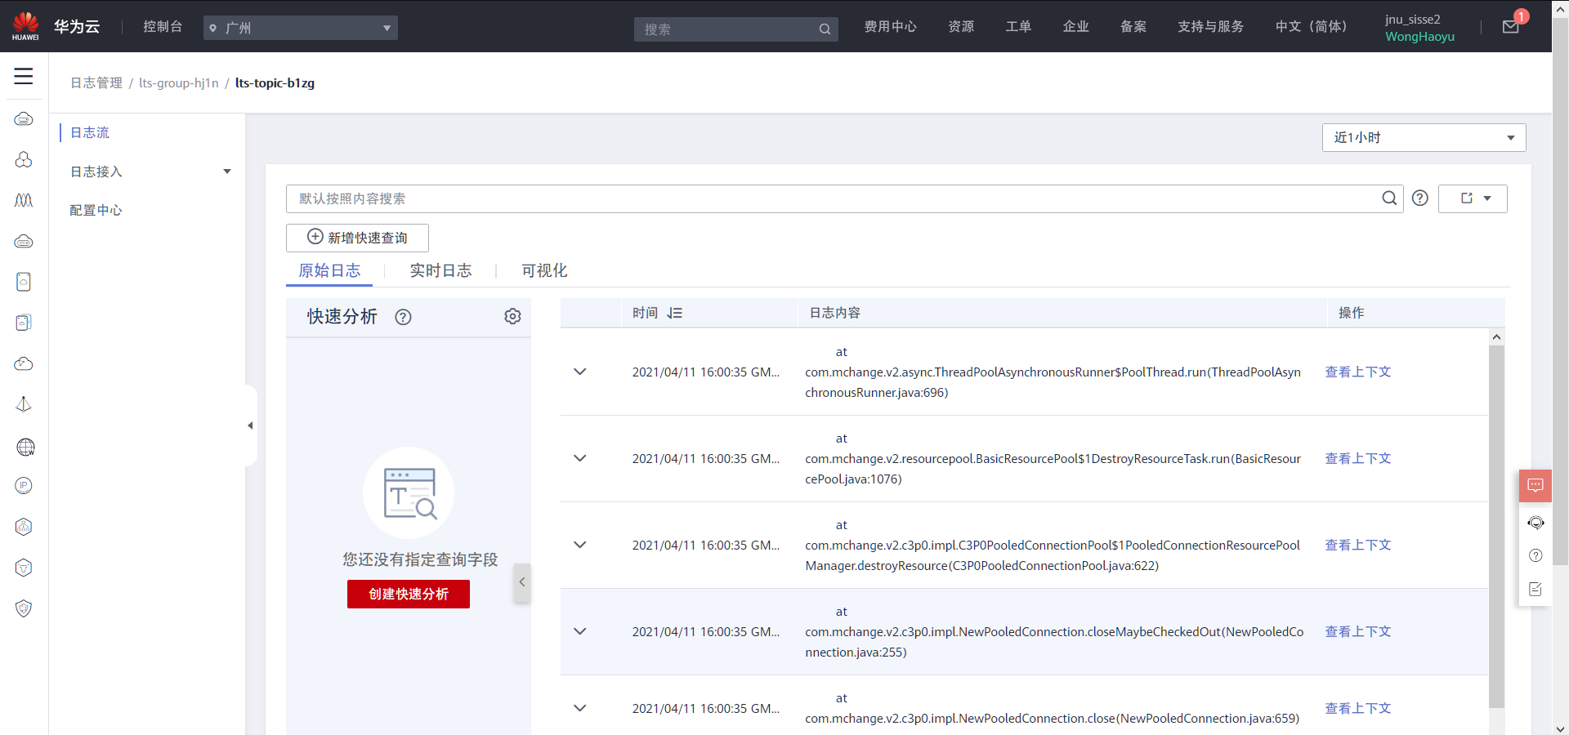
亮点12：LTS+格式化日志
LTS

Slide 41
亮点12：格式化日志
[INFO][21-04-08][com.mchange.v2.log.MLog]MLog clients using log4j logging.
[DEBUG][21-04-08][com.mchange.v2.log.MLog]Could not find resource path text file for path '/com/mchange/v2/cfg/vmConfigResourcePaths.txt'. Skipping.
[DEBUG][21-04-08][com.mchange.v2.log.MLog]Added paths from resource path text file at '/mchange-config-resource-paths.txt'
[DEBUG][21-04-08][com.mchange.v2.log.MLog]Reading VM config for path list /com/mchange/v2/log/default-mchange-log.properties, /mchange-commons.properties, /c3p0.properties, hocon:/reference,/application,/c3p0,/, /mchange-log.properties, /
[DEBUG][21-04-08][com.mchange.v2.log.MLog]The configuration file for resource identifier '/mchange-commons.properties' could not be found. Skipping.
[DEBUG][21-04-08][com.mchange.v2.log.MLog]The configuration file for resource identifier '/c3p0.properties' could not be found. Skipping.
[DEBUG][21-04-08][com.mchange.v2.log.MLog]The configuration file for resource identifier 'hocon:/reference,/application,/c3p0,/' could not be found. Skipping.
[DEBUG][21-04-08][com.mchange.v2.log.MLog]The configuration file for resource identifier '/mchange-log.properties' could not be found. Skipping.
[DEBUG][21-04-08][com.mchange.v2.log.MLog]Config available to MLog library: com.mchange.v2.cfg.BasicMultiPropertiesConfig@74ee9122 [ propertiesByResourcePaths -> {/com/mchange/v2/log/default-mchange-log.properties={com.mchange.v2.log.jdk14logging.suppressStackWalk=true}, /={java.vendor=Amazon.com Inc., sun.java.launcher=SUN_STANDARD, catalina.base=C:\Users\83599\AppData\Local\JetBrains\IntelliJIdea2020.1\tomcat\Tomcat_9_0_44_huwei, sun.management.compiler=HotSpot 64-Bit Tiered Compilers, catalina.useNaming=true, os.name=Windows 10, sun.boot.class.path=C:\Users\83599\.jdks\corretto-1.8.0_282\jre\lib\resources.jar;C:\Users\83599\.jdks\corretto-1.8.0_282\jre\lib\rt.jar;C:\Users\83599\.jdks\corretto-1.8.0_282\jre\lib\sunrsasign.jar;C:\Users\83599\.jdks\corretto-1.8.0_282\jre\lib\jsse.jar;C:\Users\83599\.jdks\corretto-1.8.0_282\jre\lib\jce.jar;C:\Users\83599\.jdks\corretto-1.8.0_282\jre\lib\charsets.jar;C:\Users\83599\.jdks\corretto-1.8.0_282\jre\lib\jfr.jar;C:\Users\83599\.jdks\corretto-1.8.0_282\jre\classes, java.util.logging.config.file=C:\Users\83599\AppData\Local\JetBrains\IntelliJIdea2020.1\tomcat\Tomcat_9_0_44_huwei\conf\logging.properties, sun.desktop=windows, com.sun.management.jmxremote=, java.vm.specification.vendor=Oracle Corporation, java.runtime.version=1.8.0_282-b08, user.name=rglkt, tomcat.util.scan.StandardJarScanFilter.jarsToScan=log4j-taglib*.jar,log4j-web*.jar,log4javascript*.jar,slf4j-taglib*.jar, shared.loader=, tomcat.util.buf.StringCache.byte.enabled=true, java.naming.factory.initial=org.apache.naming.java.javaURLContextFactory, user.language=zh, sun.boot.library.path=C:\Users\83599\.jdks\corretto-1.8.0_282\jre\bin, com.sun.management.jmxremote.port=1099, jdk.tls.ephemeralDHKeySize=2048, java.version=1.8.0_282, java.util.logging.manager=org.apache.juli.ClassLoaderLogManager, user.timezone=Asia/Shanghai, sun.arch.data.model=64, java.util.concurrent.ForkJoinPool.common.threadFactory=org.apache.catalina.startup.SafeForkJoinWorkerThreadFactory, java.endorsed.dirs=C:\Users\83599\.jdks\corretto-1.8.0_282\jre\lib\endorsed, java.rmi.server.randomIDs=true, sun.cpu.isalist=amd64, sun.jnu.encoding=GBK, file.encoding.pkg=sun.io, package.access=sun.,org.apache.catalina.,org.apache.coyote.,org.apache.jasper.,org.apache.tomcat., file.separator=\, java.specification.name=Java Platform API Specification, java.class.version=52.0, user.country=CN, java.home=C:\Users\83599\.jdks\corretto-1.8.0_282\jre, java.vm.info=mixed mode, os.version=10.0, com.sun.management.jmxremote.ssl=false, path.separator=;, java.vm.version=25.282-b08, user.variant=, java.protocol.handler.pkgs=org.apache.catalina.webresources, java.awt.printerjob=sun.awt.windows.WPrinterJob, sun.io.unicode.encoding=UnicodeLittle, awt.toolkit=sun.awt.windows.WToolkit, package.definition=sun.,java.,org.apache.catalina.,org.apache.coyote.,org.apache.jasper.,org.apache.naming.,org.apache.tomcat., user.script=, java.naming.factory.url.pkgs=org.apache.naming, user.home=C:\Users\83599, java.specification.vendor=Oracle Corporation, tomcat.util.scan.StandardJarScanFilter.jarsToSkip=annotations-api.jar,ant-junit*.jar,ant-launcher.jar,ant.jar,asm-*.jar,aspectj*.jar,bootstrap.jar,catalina-ant.jar,catalina-ha.jar,catalina-ssi.jar,catalina-storeconfig.jar,catalina-tribes.jar,catalina.jar,cglib-*.jar,cobertura-*.jar,commons-beanutils*.jar,commons-codec*.jar,commons-collections*.jar,commons-daemon.jar,commons-dbcp*.jar,commons-digester*.jar,commons-fileupload*.jar,commons-httpclient*.jar,commons-io*.jar,commons-lang*.jar,commons-logging*.jar,commons-math*.jar,commons-pool*.jar,dom4j-*.jar,easymock-*.jar,ecj-*.jar,el-api.jar,geronimo-spec-jaxrpc*.jar,h2*.jar,hamcrest-*.jar,hibernate*.jar,httpclient*.jar,icu4j-*.jar,jasper-el.jar,jasper.jar,jaspic-api.jar,jaxb-*.jar,jaxen-*.jar,jdom-*.jar,jetty-*.jar,jmx-tools.jar,jmx.jar,jsp-api.jar,jstl.jar,jta*.jar,junit-*.jar,junit.jar,log4j*.jar,mail*.jar,objenesis-*.jar,oraclepki.jar,oro-*.jar,servlet-api-*.jar,servlet-api.jar,slf4j*.jar,taglibs-standard-spec-*.jar,tagsoup-*.jar,tomcat-api.jar,tomcat-coyote.jar,tomcat-dbcp.jar,tomcat-i18n-*.jar,tomcat-jdbc.jar,tomcat-jni.jar,tomcat-juli-adapters.jar,tomcat-juli.jar,tomcat-util-scan.jar,tomcat-util.jar,tomcat-websocket.jar,tools.jar,websocket-api.jar,wsdl4j*.jar,xercesImpl.jar,xml-apis.jar,xmlParserAPIs-*.jar,xmlParserAPIs.jar,xom-*.jar, java.library.path=C:\Users\83599\.jdks\corretto-1.8.0_282\bin;C:\WINDOWS\Sun\Java\bin;C:\WINDOWS\system32;C:\WINDOWS;C:\WINDOWS\system32;C:\Program Files\Java\jdk-13\bin;C:\Users\83599\AppData\Local\Continuum\anaconda3\Scripts;C:\Users\83599\AppData\Local\Continuum\anaconda3\Library\bin;C:\Windows\System32;C:\Program Files (x86)\Google\Chrome\Application;C:\Users\83599\AppData\Local\Continuum\anaconda3\Lib\site-packages\pyqt5_tools;C:\Windows\System32\WindowsPowerShell\v1.0;C:\Program Files\PuTTY\;C:\Program Files (x86)\Microsoft Visual Studio\Common\Tools\WinNT;C:\Program Files (x86)\Microsoft Visual Studio\Common\MSDev98\Bin;C:\Program Files (x86)\Microsoft Visual Studio\Common\Tools;C:\Program Files (x86)\Microsoft Visual Studio\VC98\bin;C:\Users\83599\AppData\Local\Microsoft\WindowsApps;C:\Program Files\Bandizip\;C:\Users\83599\AppData\Local\Programs\Microsoft VS Code\bin;C:\Users\83599\AppData\Local\GitHubDesktop\bin;C:\Program Files\JetBrains\PyCharm 2020.1.1\bin;;C:\Users\83599\AppData\Local\Microsoft\WindowsApps;C:\Windows\System32;C:\Program Files (x86)\Google\Chrome\Application;;., java.vendor.url=https://aws.amazon.com/corretto/, java.vm.vendor=Amazon.com Inc., common.loader="E:/apache-tomcat-9.0.44/lib","E:/apache-tomcat-9.0.44/lib/*.jar","${catalina.home}/lib","${catalina.home}/lib/*.jar", java.runtime.name=OpenJDK Runtime Environment, sun.java.command=org.apache.catalina.startup.Bootstrap start, java.class.path=E:\apache-tomcat-9.0.44\bin\bootstrap.jar;E:\apache-tomcat-9.0.44\bin\tomcat-juli.jar, com.sun.management.jmxremote.access.file=C:\Users\83599\AppData\Local\JetBrains\IntelliJIdea2020.1\tomcat\Tomcat_9_0_44_huwei\jmxremote.access, java.vm.specification.name=Java Virtual Machine Specification, java.vm.specification.version=1.8, catalina.home=E:\apache-tomcat-9.0.44, sun.cpu.endian=little, sun.os.patch.level=, java.io.tmpdir=E:\apache-tomcat-9.0.44\temp, java.vendor.url.bug=https://github.com/corretto/corretto-8/issues/, server.loader=, java.rmi.server.hostname=127.0.0.1, os.arch=amd64, java.awt.graphicsenv=sun.awt.Win32GraphicsEnvironment, java.ext.dirs=C:\Users\83599\.jdks\corretto-1.8.0_282\jre\lib\ext;C:\WINDOWS\Sun\Java\lib\ext, user.dir=C:\Users\83599\Desktop, line.separator=
, java.vm.name=OpenJDK 64-Bit Server VM, ignore.endorsed.dirs=, file.encoding=GBK, com.sun.management.jmxremote.password.file=C:\Users\83599\AppData\Local\JetBrains\IntelliJIdea2020.1\tomcat\Tomcat_9_0_44_huwei\jmxremote.password, java.specification.version=1.8}}, propertiesByPrefixes -> {com={com.sun.management.jmxremote.password.file=C:\Users\83599\AppData\Local\JetBrains\IntelliJIdea2020.1\tomcat\Tomcat_9_0_44_huwei\jmxremote.password, com.sun.management.jmxremote.port=1099, com.sun.management.jmxremote.access.file=C:\Users\83599\AppData\Local\JetBrains\IntelliJIdea2020.1\tomcat\Tomcat_9_0_44_huwei\jmxremote.access, com.sun.management.jmxremote.ssl=false, com.sun.management.jmxremote=, com.mchange.v2.log.jdk14logging.suppressStackWalk=true}, ={java.vendor=Amazon.com Inc., sun.java.launcher=SUN_STANDARD, catalina.base=C:\Users\83599\AppData\Local\JetBrains\IntelliJIdea2020.1\tomcat\Tomcat_9_0_44_huwei, sun.management.compiler=HotSpot 64-Bit Tiered Compilers, catalina.useNaming=true, os.name=Windows 10, sun.boot.class.path=C:\Users\83599\.jdks\corretto-1.8.0_282\jre\lib\resources.jar;C:\Users\83599\.jdks\corretto-1.8.0_282\jre\lib\rt.jar;C:\Users\83599\.jdks\corretto-1.8.0_282\jre\lib\sunrsasign.jar;C:\Users\83599\.jdks\corretto-1.8.0_282\jre\lib\jsse.jar;C:\Users\83599\.jdks\corretto-1.8.0_282\jre\lib\jce.jar;C:\Users\83599\.jdks\corretto-1.8.0_282\jre\lib\charsets.jar;C:\Users\83599\.jdks\corretto-1.8.0_282\jre\lib\jfr.jar;C:\Users\83599\.jdks\corretto-1.8.0_282\jre\classes, java.util.logging.config.file=C:\Users\83599\AppData\Local\JetBrains\IntelliJIdea2020.1\tomcat\Tomcat_9_0_44_huwei\conf\logging.properties, sun.desktop=windows, com.sun.management.jmxremote=, java.vm.specification.vendor=Oracle Corporation, java.runtime.version=1.8.0_282-b08, user.name=rglkt, tomcat.util.scan.StandardJarScanFilter.jarsToScan=log4j-taglib*.jar,log4j-web*.jar,log4javascript*.jar,slf4j-taglib*.jar, shared.loader=, tomcat.util.buf.StringCache.byte.enabled=true, user.language=zh, java.naming.factory.initial=org.apache.naming.java.javaURLContextFactory, sun.boot.library.path=C:\Users\83599\.jdks\corretto-1.8.0_282\jre\bin, com.sun.management.jmxremote.port=1099, jdk.tls.ephemeralDHKeySize=2048, java.version=1.8.0_282, java.util.logging.manager=org.apache.juli.ClassLoaderLogManager, user.timezone=Asia/Shanghai, sun.arch.data.model=64, java.util.concurrent.ForkJoinPool.common.threadFactory=org.apache.catalina.startup.SafeForkJoinWorkerThreadFactory, java.endorsed.dirs=C:\Users\83599\.jdks\corretto-1.8.0_282\jre\lib\endorsed, java.rmi.server.randomIDs=true, sun.cpu.isalist=amd64, sun.jnu.encoding=GBK, file.encoding.pkg=sun.io, com.mchange.v2.log.jdk14logging.suppressStackWalk=true, package.access=sun.,org.apache.catalina.,org.apache.coyote.,org.apache.jasper.,org.apache.tomcat., file.separator=\, java.specification.name=Java Platform API Specification, java.class.version=52.0, user.country=CN, java.home=C:\Users\83599\.jdks\corretto-1.8.0_282\jre, java.vm.info=mixed mode, os.version=10.0, com.sun.management.jmxremote.ssl=false, path.separator=;, java.vm.version=25.282-b08, user.variant=, java.protocol.handler.pkgs=org.apache.catalina.webresources, java.awt.printerjob=sun.awt.windows.WPrinterJob, sun.io.unicode.encoding=UnicodeLittle, awt.toolkit=sun.awt.windows.WToolkit, package.definition=sun.,java.,org.apache.catalina.,org.apache.coyote.,org.apache.jasper.,org.apache.naming.,org.apache.tomcat., user.script=, java.naming.factory.url.pkgs=org.apache.naming, user.home=C:\Users\83599, java.specification.vendor=Oracle Corporation, tomcat.util.scan.StandardJarScanFilter.jarsToSkip=annotations-api.jar,ant-junit*.jar,ant-launcher.jar,ant.jar,asm-*.jar,aspectj*.jar,bootstrap.jar,catalina-ant.jar,catalina-ha.jar,catalina-ssi.jar,catalina-storeconfig.jar,catalina-tribes.jar,catalina.jar,cglib-*.jar,cobertura-*.jar,commons-beanutils*.jar,commons-codec*.jar,commons-collections*.jar,commons-daemon.jar,commons-dbcp*.jar,commons-digester*.jar,commons-fileupload*.jar,commons-httpclient*.jar,commons-io*.jar,commons-lang*.jar,commons-logging*.jar,commons-math*.jar,commons-pool*.jar,dom4j-*.jar,easymock-*.jar,ecj-*.jar,el-api.jar,geronimo-spec-jaxrpc*.jar,h2*.jar,hamcrest-*.jar,hibernate*.jar,httpclient*.jar,icu4j-*.jar,jasper-el.jar,jasper.jar,jaspic-api.jar,jaxb-*.jar,jaxen-*.jar,jdom-*.jar,jetty-*.jar,jmx-tools.jar,jmx.jar,jsp-api.jar,jstl.jar,jta*.jar,junit-*.jar,junit.jar,log4j*.jar,mail*.jar,objenesis-*.jar,oraclepki.jar,oro-*.jar,servlet-api-*.jar,servlet-api.jar,slf4j*.jar,taglibs-standard-spec-*.jar,tagsoup-*.jar,tomcat-api.jar,tomcat-coyote.jar,tomcat-dbcp.jar,tomcat-i18n-*.jar,tomcat-jdbc.jar,tomcat-jni.jar,tomcat-juli-adapters.jar,tomcat-juli.jar,tomcat-util-scan.jar,tomcat-util.jar,tomcat-websocket.jar,tools.jar,websocket-api.jar,wsdl4j*.jar,xercesImpl.jar,xml-apis.jar,xmlParserAPIs-*.jar,xmlParserAPIs.jar,xom-*.jar, java.library.path=C:\Users\83599\.jdks\corretto-1.8.0_282\bin;C:\WINDOWS\Sun\Java\bin;C:\WINDOWS\system32;C:\WINDOWS;C:\WINDOWS\system32;C:\Program Files\Java\jdk-13\bin;C:\Users\83599\AppData\Local\Continuum\anaconda3\Scripts;C:\Users\83599\AppData\Local\Continuum\anaconda3\Library\bin;C:\Windows\System32;C:\Program Files (x86)\Google\Chrome\Application;C:\Users\83599\AppData\Local\Continuum\anaconda3\Lib\site-packages\pyqt5_tools;C:\Windows\System32\WindowsPowerShell\v1.0;C:\Program Files\PuTTY\;C:\Program Files (x86)\Microsoft Visual Studio\Common\Tools\WinNT;C:\Program Files (x86)\Microsoft Visual Studio\Common\MSDev98\Bin;C:\Program Files (x86)\Microsoft Visual Studio\Common\Tools;C:\Program Files (x86)\Microsoft Visual Studio\VC98\bin;C:\Users\83599\AppData\Local\Microsoft\WindowsApps;C:\Program Files\Bandizip\;C:\Users\83599\AppData\Local\Programs\Microsoft VS Code\bin;C:\Users\83599\AppData\Local\GitHubDesktop\bin;C:\Program Files\JetBrains\PyCharm 2020.1.1\bin;;C:\Users\83599\AppData\Local\Microsoft\WindowsApps;C:\Windows\System32;C:\Program Files (x86)\Google\Chrome\Application;;., java.vendor.url=https://aws.amazon.com/corretto/, java.vm.vendor=Amazon.com Inc., common.loader="E:/apache-tomcat-9.0.44/lib","E:/apache-tomcat-9.0.44/lib/*.jar","${catalina.home}/lib","${catalina.home}/lib/*.jar", java.runtime.name=OpenJDK Runtime Environment, sun.java.command=org.apache.catalina.startup.Bootstrap start, java.class.path=E:\apache-tomcat-9.0.44\bin\bootstrap.jar;E:\apache-tomcat-9.0.44\bin\tomcat-juli.jar, com.sun.management.jmxremote.access.file=C:\Users\83599\AppData\Local\JetBrains\IntelliJIdea2020.1\tomcat\Tomcat_9_0_44_huwei\jmxremote.access, java.vm.specification.name=Java Virtual Machine Specification, java.vm.specification.version=1.8, catalina.home=E:\apache-tomcat-9.0.44, sun.cpu.endian=little, sun.os.patch.level=, java.io.tmpdir=E:\apache-tomcat-9.0.44\temp, java.vendor.url.bug=https://github.com/corretto/corretto-8/issues/, server.loader=, java.rmi.server.hostname=127.0.0.1, java.awt.graphicsenv=sun.awt.Win32GraphicsEnvironment, os.arch=amd64, java.ext.dirs=C:\Users\83599\.jdks\corretto-1.8.0_282\jre\lib\ext;C:\WINDOWS\Sun\Java\lib\ext, user.dir=C:\Users\83599\Desktop, line.separator=
, java.vm.name=OpenJDK 64-Bit Server VM, ignore.endorsed.dirs=, file.encoding=GBK, com.sun.management.jmxremote.password.file=C:\Users\83599\AppData\Local\JetBrains\IntelliJIdea2020.1\tomcat\Tomcat_9_0_44_huwei\jmxremote.password, java.specification.version=1.8}, tomcat.util.scan={tomcat.util.scan.StandardJarScanFilter.jarsToScan=log4j-taglib*.jar,log4j-web*.jar,log4javascript*.jar,slf4j-taglib*.jar, tomcat.util.scan.StandardJarScanFilter.jarsToSkip=annotations-api.jar,ant-junit*.jar,ant-launcher.jar,ant.jar,asm-*.jar,aspectj*.jar,bootstrap.jar,catalina-ant.jar,catalina-ha.jar,catalina-ssi.jar,catalina-storeconfig.jar,catalina-tribes.jar,catalina.jar,cglib-*.jar,cobertura-*.jar,commons-beanutils*.jar,commons-codec*.jar,commons-collections*.jar,commons-daemon.jar,commons-dbcp*.jar,commons-digester*.jar,commons-fileupload*.jar,commons-httpclient*.jar,commons-io*.jar,commons-lang*.jar,commons-logging*.jar,commons-math*.jar,commons-pool*.jar,dom4j-*.jar,easymock-*.jar,ecj-*.jar,el-api.jar,geronimo-spec-jaxrpc*.jar,h2*.jar,hamcrest-*.jar,hibernate*.jar,httpclient*.jar,icu4j-*.jar,jasper-el.jar,jasper.jar,jaspic-api.jar,jaxb-*.jar,jaxen-*.jar,jdom-*.jar,jetty-*.jar,jmx-tools.jar,jmx.jar,jsp-api.jar,jstl.jar,jta*.jar,junit-*.jar,junit.jar,log4j*.jar,mail*.jar,objenesis-*.jar,oraclepki.jar,oro-*.jar,servlet-api-*.jar,servlet-api.jar,slf4j*.jar,taglibs-standard-spec-*.jar,tagsoup-*.jar,tomcat-api.jar,tomcat-coyote.jar,tomcat-dbcp.jar,tomcat-i18n-*.jar,tomcat-jdbc.jar,tomcat-jni.jar,tomcat-juli-adapters.jar,tomcat-juli.jar,tomcat-util-scan.jar,tomcat-util.jar,tomcat-websocket.jar,tools.jar,websocket-api.jar,wsdl4j*.jar,xercesImpl.jar,xml-apis.jar,xmlParserAPIs-*.jar,xmlParserAPIs.jar,xom-*.jar}, java.rmi={java.rmi.server.randomIDs=true, java.rmi.server.hostname=127.0.0.1}, sun.management={sun.management.compiler=HotSpot 64-Bit Tiered Compilers}, java.vm={java.vm.version=25.282-b08, java.vm.specification.name=Java Virtual Machine Specification, java.vm.specification.vendor=Oracle Corporation, java.vm.name=OpenJDK 64-Bit Server VM, java.vm.specification.version=1.8, java.vm.vendor=Amazon.com Inc., java.vm.info=mixed mode}, tomcat={tomcat.util.scan.StandardJarScanFilter.jarsToScan=log4j-taglib*.jar,log4j-web*.jar,log4javascript*.jar,slf4j-taglib*.jar, tomcat.util.buf.StringCache.byte.enabled=true, tomcat.util.scan.StandardJarScanFilter.jarsToSkip=annotations-api.jar,ant-junit*.jar,ant-launcher.jar,ant.jar,asm-*.jar,aspectj*.jar,bootstrap.jar,catalina-ant.jar,catalina-ha.jar,catalina-ssi.jar,catalina-storeconfig.jar,catalina-tribes.jar,catalina.jar,cglib-*.jar,cobertura-*.jar,commons-beanutils*.jar,commons-codec*.jar,commons-collections*.jar,commons-daemon.jar,commons-dbcp*.jar,commons-digester*.jar,commons-fileupload*.jar,commons-httpclient*.jar,commons-io*.jar,commons-lang*.jar,commons-logging*.jar,commons-math*.jar,commons-pool*.jar,dom4j-*.jar,easymock-*.jar,ecj-*.jar,el-api.jar,geronimo-spec-jaxrpc*.jar,h2*.jar,hamcrest-*.jar,hibernate*.jar,httpclient*.jar,icu4j-*.jar,jasper-el.jar,jasper.jar,jaspic-api.jar,jaxb-*.jar,jaxen-*.jar,jdom-*.jar,jetty-*.jar,jmx-tools.jar,jmx.jar,jsp-api.jar,jstl.jar,jta*.jar,junit-*.jar,junit.jar,log4j*.jar,mail*.jar,objenesis-*.jar,oraclepki.jar,oro-*.jar,servlet-api-*.jar,servlet-api.jar,slf4j*.jar,taglibs-standard-spec-*.jar,tagsoup-*.jar,tomcat-api.jar,tomcat-coyote.jar,tomcat-dbcp.jar,tomcat-i18n-*.jar,tomcat-jdbc.jar,tomcat-jni.jar,tomcat-juli-adapters.jar,tomcat-juli.jar,tomcat-util-scan.jar,tomcat-util.jar,tomcat-websocket.jar,tools.jar,websocket-api.jar,wsdl4j*.jar,xercesImpl.jar,xml-apis.jar,xmlParserAPIs-*.jar,xmlParserAPIs.jar,xom-*.jar}, java.util.logging.config={java.util.logging.config.file=C:\Users\83599\AppData\Local\JetBrains\IntelliJIdea2020.1\tomcat\Tomcat_9_0_44_huwei\conf\logging.properties}, sun.boot.class={sun.boot.class.path=C:\Users\83599\.jdks\corretto-1.8.0_282\jre\lib\resources.jar;C:\Users\83599\.jdks\corretto-1.8.0_282\jre\lib\rt.jar;C:\Users\83599\.jdks\corretto-1.8.0_282\jre\lib\sunrsasign.jar;C:\Users\83599\.jdks\corretto-1.8.0_282\jre\lib\jsse.jar;C:\Users\83599\.jdks\corretto-1.8.0_282\jre\lib\jce.jar;C:\Users\83599\.jdks\corretto-1.8.0_282\jre\lib\charsets.jar;C:\Users\83599\.jdks\corretto-1.8.0_282\jre\lib\jfr.jar;C:\Users\83599\.jdks\corretto-1.8.0_282\jre\classes}, jdk.tls={jdk.tls.ephemeralDHKeySize=2048}, path={path.separator=;}, java={java.class.path=E:\apache-tomcat-9.0.44\bin\bootstrap.jar;E:\apache-tomcat-9.0.44\bin\tomcat-juli.jar, java.ext.dirs=C:\Users\83599\.jdks\corretto-1.8.0_282\jre\lib\ext;C:\WINDOWS\Sun\Java\lib\ext, java.runtime.name=OpenJDK Runtime Environment, java.runtime.version=1.8.0_282-b08, java.specification.version=1.8, java.vendor=Amazon.com Inc., java.class.version=52.0, java.util.logging.config.file=C:\Users\83599\AppData\Local\JetBrains\IntelliJIdea2020.1\tomcat\Tomcat_9_0_44_huwei\conf\logging.properties, java.vendor.url=https://aws.amazon.com/corretto/, java.specification.name=Java Platform API Specification, java.util.concurrent.ForkJoinPool.common.threadFactory=org.apache.catalina.startup.SafeForkJoinWorkerThreadFactory, java.awt.printerjob=sun.awt.windows.WPrinterJob, java.naming.factory.url.pkgs=org.apache.naming, java.vm.version=25.282-b08, java.home=C:\Users\83599\.jdks\corretto-1.8.0_282\jre, java.endorsed.dirs=C:\Users\83599\.jdks\corretto-1.8.0_282\jre\lib\endorsed, java.rmi.server.randomIDs=true, java.version=1.8.0_282, java.awt.graphicsenv=sun.awt.Win32GraphicsEnvironment, java.vm.specification.version=1.8, java.vendor.url.bug=https://github.com/corretto/corretto-8/issues/, java.util.logging.manager=org.apache.juli.ClassLoaderLogManager, java.vm.specification.name=Java Virtual Machine Specification, java.specification.vendor=Oracle Corporation, java.naming.factory.initial=org.apache.naming.java.javaURLContextFactory, java.vm.vendor=Amazon.com Inc., java.rmi.server.hostname=127.0.0.1, java.vm.info=mixed mode, java.library.path=C:\Users\83599\.jdks\corretto-1.8.0_282\bin;C:\WINDOWS\Sun\Java\bin;C:\WINDOWS\system32;C:\WINDOWS;C:\WINDOWS\system32;C:\Program Files\Java\jdk-13\bin;C:\Users\83599\AppData\Local\Continuum\anaconda3\Scripts;C:\Users\83599\AppData\Local\Continuum\anaconda3\Library\bin;C:\Windows\System32;C:\Program Files (x86)\Google\Chrome\Application;C:\Users\83599\AppData\Local\Continuum\anaconda3\Lib\site-packages\pyqt5_tools;C:\Windows\System32\WindowsPowerShell\v1.0;C:\Program Files\PuTTY\;C:\Program Files (x86)\Microsoft Visual Studio\Common\Tools\WinNT;C:\Program Files (x86)\Microsoft Visual Studio\Common\MSDev98\Bin;C:\Program Files (x86)\Microsoft Visual Studio\Common\Tools;C:\Program Files (x86)\Microsoft Visual Studio\VC98\bin;C:\Users\83599\AppData\Local\Microsoft\WindowsApps;C:\Program Files\Bandizip\;C:\Users\83599\AppData\Local\Programs\Microsoft VS Code\bin;C:\Users\83599\AppData\Local\GitHubDesktop\bin;C:\Program Files\JetBrains\PyCharm 2020.1.1\bin;;C:\Users\83599\AppData\Local\Microsoft\WindowsApps;C:\Windows\System32;C:\Program Files (x86)\Google\Chrome\Application;;., java.protocol.handler.pkgs=org.apache.catalina.webresources, java.vm.name=OpenJDK 64-Bit Server VM, java.vm.specification.vendor=Oracle Corporation, java.io.tmpdir=E:\apache-tomcat-9.0.44\temp}, java.vendor.url={java.vendor.url.bug=https://github.com/corretto/corretto-8/issues/}, com.mchange.v2.log={com.mchange.v2.log.jdk14logging.suppressStackWalk=true}, java.ext={java.ext.dirs=C:\Users\83599\.jdks\corretto-1.8.0_282\jre\lib\ext;C:\WINDOWS\Sun\Java\lib\ext}, sun.boot={sun.boot.library.path=C:\Users\83599\.jdks\corretto-1.8.0_282\jre\bin, sun.boot.class.path=C:\Users\83599\.jdks\corretto-1.8.0_282\jre\lib\resources.jar;C:\Users\83599\.jdks\corretto-1.8.0_282\jre\lib\rt.jar;C:\Users\83599\.jdks\corretto-1.8.0_282\jre\lib\sunrsasign.jar;C:\Users\83599\.jdks\corretto-1.8.0_282\jre\lib\jsse.jar;C:\Users\83599\.jdks\corretto-1.8.0_282\jre\lib\jce.jar;C:\Users\83599\.jdks\corretto-1.8.0_282\jre\lib\charsets.jar;C:\Users\83599\.jdks\corretto-1.8.0_282\jre\lib\jfr.jar;C:\Users\83599\.jdks\corretto-1.8.0_282\jre\classes}, com.sun.management.jmxremote={com.sun.management.jmxremote.password.file=C:\Users\83599\AppData\Local\JetBrains\IntelliJIdea2020.1\tomcat\Tomcat_9_0_44_huwei\jmxremote.password, com.sun.management.jmxremote.port=1099, com.sun.management.jmxremote.access.file=C:\Users\83599\AppData\Local\JetBrains\IntelliJIdea2020.1\tomcat\Tomcat_9_0_44_huwei\jmxremote.access, com.sun.management.jmxremote.ssl=false}, package={package.access=sun.,org.apache.catalina.,org.apache.coyote.,org.apache.jasper.,org.apache.tomcat., package.definition=sun.,java.,org.apache.catalina.,org.apache.coyote.,org.apache.jasper.,org.apache.naming.,org.apache.tomcat.}, java.util.concurrent={java.util.concurrent.ForkJoinPool.common.threadFactory=org.apache.catalina.startup.SafeForkJoinWorkerThreadFactory}, sun.os={sun.os.patch.level=}, sun.boot.library={sun.boot.library.path=C:\Users\83599\.jdks\corretto-1.8.0_282\jre\bin}, com.sun.management.jmxremote.password={com.sun.management.jmxremote.password.file=C:\Users\83599\AppData\Local\JetBrains\IntelliJIdea2020.1\tomcat\Tomcat_9_0_44_huwei\jmxremote.password}, java.rmi.server={java.rmi.server.randomIDs=true, java.rmi.server.hostname=127.0.0.1}, java.class={java.class.path=E:\apache-tomcat-9.0.44\bin\bootstrap.jar;E:\apache-tomcat-9.0.44\bin\tomcat-juli.jar, java.class.version=52.0}, com.mchange={com.mchange.v2.log.jdk14logging.suppressStackWalk=true}, java.vm.specification={java.vm.specification.name=Java Virtual Machine Specification, java.vm.specification.vendor=Oracle Corporation, java.vm.specification.version=1.8}, java.util.concurrent.ForkJoinPool.common={java.util.concurrent.ForkJoinPool.common.threadFactory=org.apache.catalina.startup.SafeForkJoinWorkerThreadFactory}, java.library={java.library.path=C:\Users\83599\.jdks\corretto-1.8.0_282\bin;C:\WINDOWS\Sun\Java\bin;C:\WINDOWS\system32;C:\WINDOWS;C:\WINDOWS\system32;C:\Program Files\Java\jdk-13\bin;C:\Users\83599\AppData\Local\Continuum\anaconda3\Scripts;C:\Users\83599\AppData\Local\Continuum\anaconda3\Library\bin;C:\Windows\System32;C:\Program Files (x86)\Google\Chrome\Application;C:\Users\83599\AppData\Local\Continuum\anaconda3\Lib\site-packages\pyqt5_tools;C:\Windows\System32\WindowsPowerShell\v1.0;C:\Program Files\PuTTY\;C:\Program Files (x86)\Microsoft Visual Studio\Common\Tools\WinNT;C:\Program Files (x86)\Microsoft Visual Studio\Common\MSDev98\Bin;C:\Program Files (x86)\Microsoft Visual Studio\Common\Tools;C:\Program Files (x86)\Microsoft Visual Studio\VC98\bin;C:\Users\83599\AppData\Local\Microsoft\WindowsApps;C:\Program Files\Bandizip\;C:\Users\83599\AppData\Local\Programs\Microsoft VS Code\bin;C:\Users\83599\AppData\Local\GitHubDesktop\bin;C:\Program Files\JetBrains\PyCharm 2020.1.1\bin;;C:\Users\83599\AppData\Local\Microsoft\WindowsApps;C:\Windows\System32;C:\Program Files (x86)\Google\Chrome\Application;;.}, sun.os.patch={sun.os.patch.level=}, com.mchange.v2.log.jdk14logging={com.mchange.v2.log.jdk14logging.suppressStackWalk=true}, java.endorsed={java.endorsed.dirs=C:\Users\83599\.jdks\corretto-1.8.0_282\jre\lib\endorsed}, sun.jnu={sun.jnu.encoding=GBK}, java.naming.factory.url={java.naming.factory.url.pkgs=org.apache.naming}, java.protocol.handler={java.protocol.handler.pkgs=org.apache.catalina.webresources}, sun.cpu={sun.cpu.endian=little, sun.cpu.isalist=amd64}, java.util.logging={java.util.logging.manager=org.apache.juli.ClassLoaderLogManager, java.util.logging.config.file=C:\Users\83599\AppData\Local\JetBrains\IntelliJIdea2020.1\tomcat\Tomcat_9_0_44_huwei\conf\logging.properties}, shared={shared.loader=}, java.protocol={java.protocol.handler.pkgs=org.apache.catalina.webresources}, server={server.loader=}, java.util={java.util.logging.manager=org.apache.juli.ClassLoaderLogManager, java.util.concurrent.ForkJoinPool.common.threadFactory=org.apache.catalina.startup.SafeForkJoinWorkerThreadFactory, java.util.logging.config.file=C:\Users\83599\AppData\Local\JetBrains\IntelliJIdea2020.1\tomcat\Tomcat_9_0_44_huwei\conf\logging.properties}, line={line.separator=
}, sun.java={sun.java.launcher=SUN_STANDARD, sun.java.command=org.apache.catalina.startup.Bootstrap start}, sun={sun.arch.data.model=64, sun.java.launcher=SUN_STANDARD, sun.desktop=windows, sun.java.command=org.apache.catalina.startup.Bootstrap start, sun.os.patch.level=, sun.management.compiler=HotSpot 64-Bit Tiered Compilers, sun.boot.class.path=C:\Users\83599\.jdks\corretto-1.8.0_282\jre\lib\resources.jar;C:\Users\83599\.jdks\corretto-1.8.0_282\jre\lib\rt.jar;C:\Users\83599\.jdks\corretto-1.8.0_282\jre\lib\sunrsasign.jar;C:\Users\83599\.jdks\corretto-1.8.0_282\jre\lib\jsse.jar;C:\Users\83599\.jdks\corretto-1.8.0_282\jre\lib\jce.jar;C:\Users\83599\.jdks\corretto-1.8.0_282\jre\lib\charsets.jar;C:\Users\83599\.jdks\corretto-1.8.0_282\jre\lib\jfr.jar;C:\Users\83599\.jdks\corretto-1.8.0_282\jre\classes, sun.jnu.encoding=GBK, sun.cpu.isalist=amd64, sun.boot.library.path=C:\Users\83599\.jdks\corretto-1.8.0_282\jre\bin, sun.cpu.endian=little, sun.io.unicode.encoding=UnicodeLittle}, tomcat.util.buf={tomcat.util.buf.StringCache.byte.enabled=true}, sun.arch.data={sun.arch.data.model=64}, file={file.separator=\, file.encoding.pkg=sun.io, file.encoding=GBK}, java.naming={java.naming.factory.initial=org.apache.naming.java.javaURLContextFactory, java.naming.factory.url.pkgs=org.apache.naming}, file.encoding={file.encoding.pkg=sun.io}, common={common.loader="E:/apache-tomcat-9.0.44/lib","E:/apache-tomcat-9.0.44/lib/*.jar","${catalina.home}/lib","${catalina.home}/lib/*.jar"}, ignore.endorsed={ignore.endorsed.dirs=}, com.sun={com.sun.management.jmxremote.password.file=C:\Users\83599\AppData\Local\JetBrains\IntelliJIdea2020.1\tomcat\Tomcat_9_0_44_huwei\jmxremote.password, com.sun.management.jmxremote.port=1099, com.sun.management.jmxremote.access.file=C:\Users\83599\AppData\Local\JetBrains\IntelliJIdea2020.1\tomcat\Tomcat_9_0_44_huwei\jmxremote.access, com.sun.management.jmxremote.ssl=false, com.sun.management.jmxremote=}, com.sun.management.jmxremote.access={com.sun.management.jmxremote.access.file=C:\Users\83599\AppData\Local\JetBrains\IntelliJIdea2020.1\tomcat\Tomcat_9_0_44_huwei\jmxremote.access}, ignore={ignore.endorsed.dirs=}, java.naming.factory={java.naming.factory.initial=org.apache.naming.java.javaURLContextFactory, java.naming.factory.url.pkgs=org.apache.naming}, java.specification={java.specification.version=1.8, java.specification.vendor=Oracle Corporation, java.specification.name=Java Platform API Specification}, sun.io.unicode={sun.io.unicode.encoding=UnicodeLittle}, tomcat.util.scan.StandardJarScanFilter={tomcat.util.scan.StandardJarScanFilter.jarsToScan=log4j-taglib*.jar,log4j-web*.jar,log4javascript*.jar,slf4j-taglib*.jar, tomcat.util.scan.StandardJarScanFilter.jarsToSkip=annotations-api.jar,ant-junit*.jar,ant-launcher.jar,ant.jar,asm-*.jar,aspectj*.jar,bootstrap.jar,catalina-ant.jar,catalina-ha.jar,catalina-ssi.jar,catalina-storeconfig.jar,catalina-tribes.jar,catalina.jar,cglib-*.jar,cobertura-*.jar,commons-beanutils*.jar,commons-codec*.jar,commons-collections*.jar,commons-daemon.jar,commons-dbcp*.jar,commons-digester*.jar,commons-fileupload*.jar,commons-httpclient*.jar,commons-io*.jar,commons-lang*.jar,commons-logging*.jar,commons-math*.jar,commons-pool*.jar,dom4j-*.jar,easymock-*.jar,ecj-*.jar,el-api.jar,geronimo-spec-jaxrpc*.jar,h2*.jar,hamcrest-*.jar,hibernate*.jar,httpclient*.jar,icu4j-*.jar,jasper-el.jar,jasper.jar,jaspic-api.jar,jaxb-*.jar,jaxen-*.jar,jdom-*.jar,jetty-*.jar,jmx-tools.jar,jmx.jar,jsp-api.jar,jstl.jar,jta*.jar,junit-*.jar,junit.jar,log4j*.jar,mail*.jar,objenesis-*.jar,oraclepki.jar,oro-*.jar,servlet-api-*.jar,servlet-api.jar,slf4j*.jar,taglibs-standard-spec-*.jar,tagsoup-*.jar,tomcat-api.jar,tomcat-coyote.jar,tomcat-dbcp.jar,tomcat-i18n-*.jar,tomcat-jdbc.jar,tomcat-jni.jar,tomcat-juli-adapters.jar,tomcat-juli.jar,tomcat-util-scan.jar,tomcat-util.jar,tomcat-websocket.jar,tools.jar,websocket-api.jar,wsdl4j*.jar,xercesImpl.jar,xml-apis.jar,xmlParserAPIs-*.jar,xmlParserAPIs.jar,xom-*.jar}, os={os.version=10.0, os.name=Windows 10, os.arch=amd64}, com.mchange.v2={com.mchange.v2.log.jdk14logging.suppressStackWalk=true}, sun.io={sun.io.unicode.encoding=UnicodeLittle}, java.runtime={java.runtime.version=1.8.0_282-b08, java.runtime.name=OpenJDK Runtime Environment}, jdk={jdk.tls.ephemeralDHKeySize=2048}, java.awt={java.awt.printerjob=sun.awt.windows.WPrinterJob, java.awt.graphicsenv=sun.awt.Win32GraphicsEnvironment}, tomcat.util={tomcat.util.scan.StandardJarScanFilter.jarsToScan=log4j-taglib*.jar,log4j-web*.jar,log4javascript*.jar,slf4j-taglib*.jar, tomcat.util.buf.StringCache.byte.enabled=true, tomcat.util.scan.StandardJarScanFilter.jarsToSkip=annotations-api.jar,ant-junit*.jar,ant-launcher.jar,ant.jar,asm-*.jar,aspectj*.jar,bootstrap.jar,catalina-ant.jar,catalina-ha.jar,catalina-ssi.jar,catalina-storeconfig.jar,catalina-tribes.jar,catalina.jar,cglib-*.jar,cobertura-*.jar,commons-beanutils*.jar,commons-codec*.jar,commons-collections*.jar,commons-daemon.jar,commons-dbcp*.jar,commons-digester*.jar,commons-fileupload*.jar,commons-httpclient*.jar,commons-io*.jar,commons-lang*.jar,commons-logging*.jar,commons-math*.jar,commons-pool*.jar,dom4j-*.jar,easymock-*.jar,ecj-*.jar,el-api.jar,geronimo-spec-jaxrpc*.jar,h2*.jar,hamcrest-*.jar,hibernate*.jar,httpclient*.jar,icu4j-*.jar,jasper-el.jar,jasper.jar,jaspic-api.jar,jaxb-*.jar,jaxen-*.jar,jdom-*.jar,jetty-*.jar,jmx-tools.jar,jmx.jar,jsp-api.jar,jstl.jar,jta*.jar,junit-*.jar,junit.jar,log4j*.jar,mail*.jar,objenesis-*.jar,oraclepki.jar,oro-*.jar,servlet-api-*.jar,servlet-api.jar,slf4j*.jar,taglibs-standard-spec-*.jar,tagsoup-*.jar,tomcat-api.jar,tomcat-coyote.jar,tomcat-dbcp.jar,tomcat-i18n-*.jar,tomcat-jdbc.jar,tomcat-jni.jar,tomcat-juli-adapters.jar,tomcat-juli.jar,tomcat-util-scan.jar,tomcat-util.jar,tomcat-websocket.jar,tools.jar,websocket-api.jar,wsdl4j*.jar,xercesImpl.jar,xml-apis.jar,xmlParserAPIs-*.jar,xmlParserAPIs.jar,xom-*.jar}, com.sun.management={com.sun.management.jmxremote.password.file=C:\Users\83599\AppData\Local\JetBrains\IntelliJIdea2020.1\tomcat\Tomcat_9_0_44_huwei\jmxremote.password, com.sun.management.jmxremote.port=1099, com.sun.management.jmxremote.access.file=C:\Users\83599\AppData\Local\JetBrains\IntelliJIdea2020.1\tomcat\Tomcat_9_0_44_huwei\jmxremote.access, com.sun.management.jmxremote.ssl=false, com.sun.management.jmxremote=}, sun.arch={sun.arch.data.model=64}, tomcat.util.buf.StringCache.byte={tomcat.util.buf.StringCache.byte.enabled=true}, java.vendor={java.vendor.url.bug=https://github.com/corretto/corretto-8/issues/, java.vendor.url=https://aws.amazon.com/corretto/}, java.io={java.io.tmpdir=E:\apache-tomcat-9.0.44\temp}, java.util.concurrent.ForkJoinPool={java.util.concurrent.ForkJoinPool.common.threadFactory=org.apache.catalina.startup.SafeForkJoinWorkerThreadFactory}, catalina={catalina.base=C:\Users\83599\AppData\Local\JetBrains\IntelliJIdea2020.1\tomcat\Tomcat_9_0_44_huwei, catalina.home=E:\apache-tomcat-9.0.44, catalina.useNaming=true}, tomcat.util.buf.StringCache={tomcat.util.buf.StringCache.byte.enabled=true}, user={user.name=rglkt, user.country=CN, user.timezone=Asia/Shanghai, user.dir=C:\Users\83599\Desktop, user.home=C:\Users\83599, user.language=zh, user.script=, user.variant=}, awt={awt.toolkit=sun.awt.windows.WToolkit}} ]
RAW Log

Slide 42
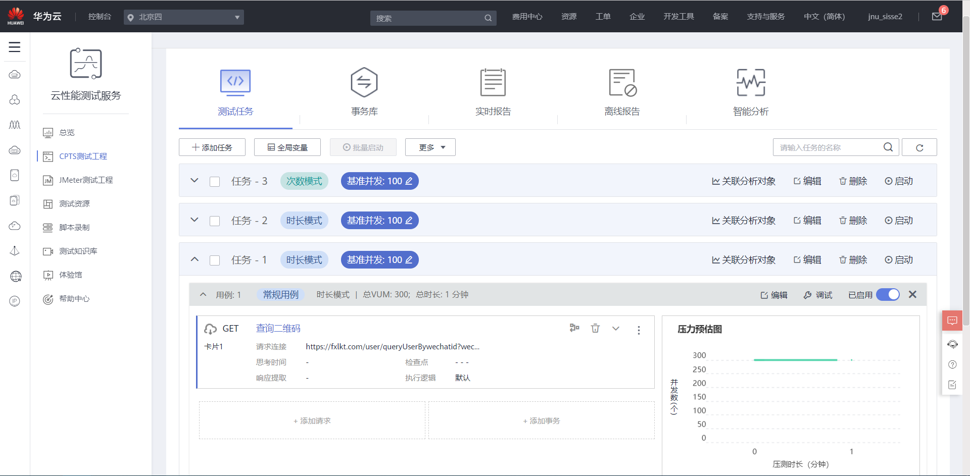
亮点13：云性能测试
云性能测试

Slide 43
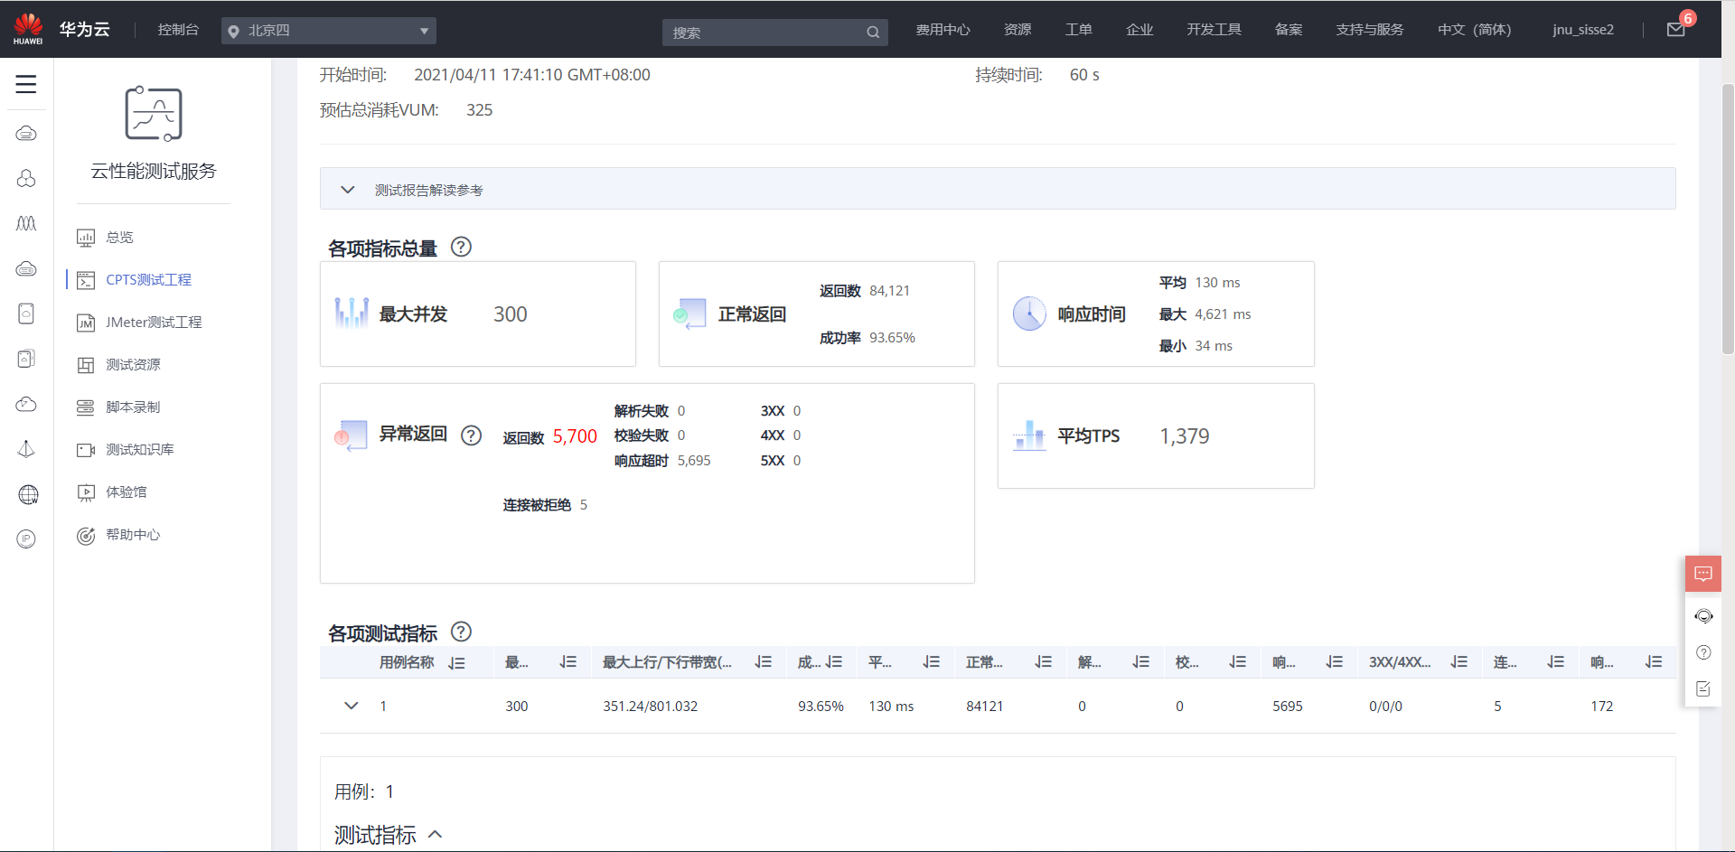
亮点13：云性能测试
云性能测试

Slide 44
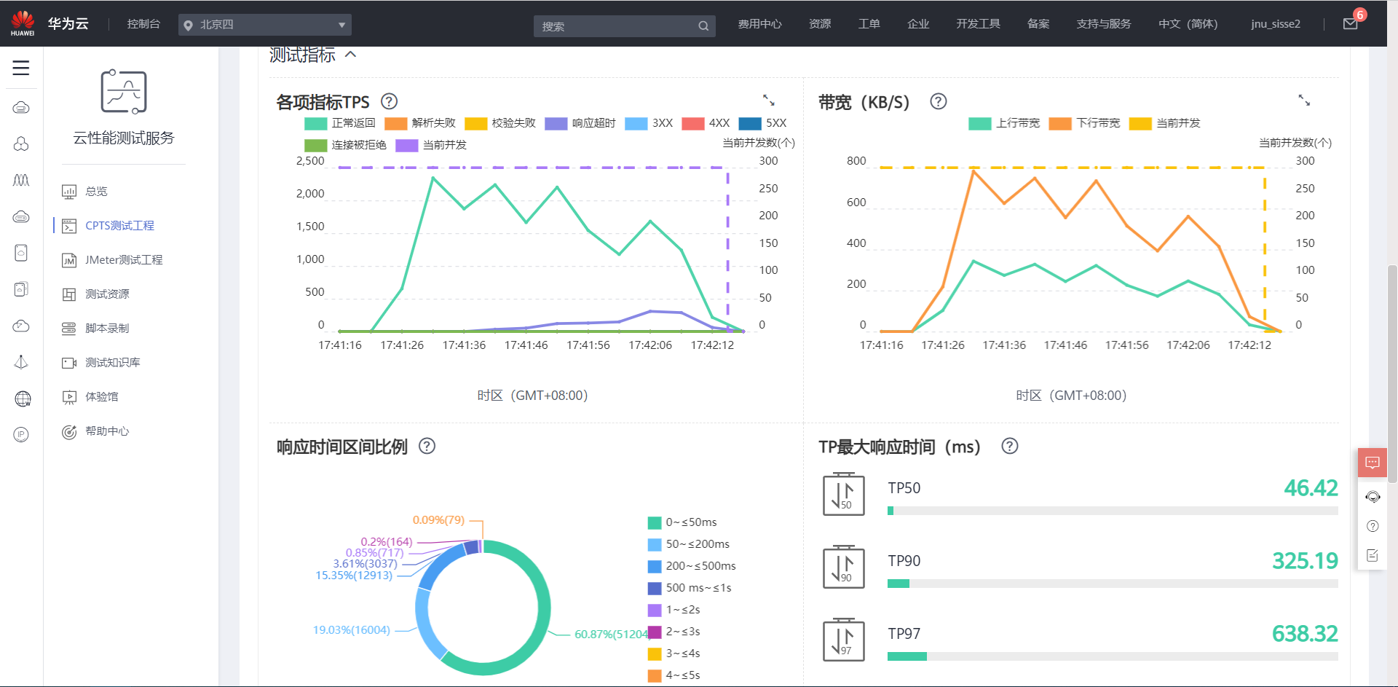
亮点13：云性能测试
云性能测试

Slide 45
THANK YOU
FOR WATCHING！

